Slide 1
RFS Integration Schemas
UBL 2.0 based messages
Tuesday, September 06, 2011
Edited on october 19, 2011

Slide 2
RFS Integration Schemas
Based on an international standard: UBL 2.0
Are defined in XSD files, supported by xlsx
A generic RFS solution, not only for ERP
Schema definitions are a subset of UBL 2.0
Each subset is a different profile
Extensions to UBL 2.0 have a special location within the message

Slide 3
RFS Integration Schemas
Owned by RFS Holding
Maintained by the data manager (Klaas/Dirk)
Changes should be addressed to data manager
Development time changes allowed, but lasting changes should be requested for
Test and production schemas are provided by the data manager

Slide 4
RFS Integration Schemas
Available through portal (zip file with current versions)
For now, all XSD files contain version 1.0 (version is the same until end of project)
Xlsx files contain an actual version, smaller than 1.0

Slide 5
UBL 2.0
Universal Business Language
Package of xml message to support generic business interaction
Based on a generic use case
International standard, used in Europe
Supports customization
Scandinavia uses a customized version: NES

Slide 6
Structure
Root for all RFS schemas
file: /Rfs.Integration.Schemas/[ProfileName]/
namespace: http://schemas.rfsholding.com/[profilename]/
Schemas defined in XSD and xlsx
Future: either XSD as source or XSD generated from xlsx

Slide 7
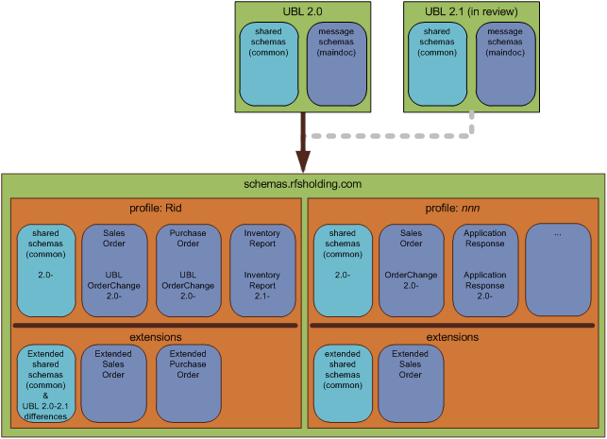
Customization

Slide 8
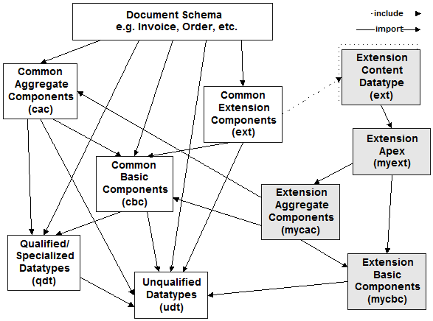
Customization

Slide 9
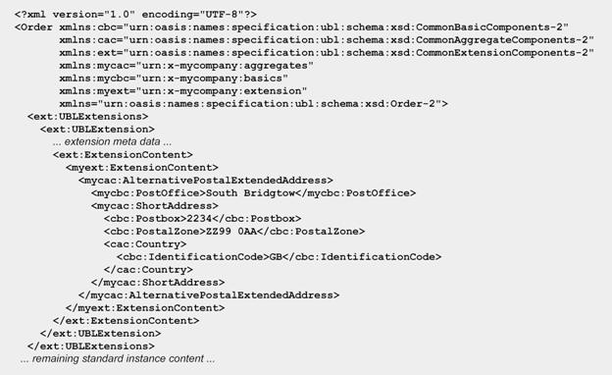
Customization

Slide 10
Directories
doc
Contains description or other information
common
Contains shared definitions
maindoc
Contains messages
xlsx
Contains spreadsheets

Slide 11
Directories
common contains all UBL common files, restricted for RFS usage, and any extension that is not a message.
maindoc contains only messages and message extensions
Each message in maindoc has a related xlsx in the xlsx directory

Slide 12
Filenames
Filename:
[Schemaprofile]-[MessageName]-v[version].[subversion].[ext]
Rid-SalesOrder-v1.0.xsd
Rid-SalesORder-v0.2.xlsx
Extensions:
[Schemaprofile]-Extended[MessageName]-v[version].[subversion].[ext]
Rid-ExtendedSalesOrder-v1.0.xsd
Rid-ExtendedSalesORder-v0.2.xlsx

Slide 13
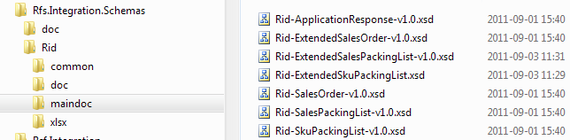
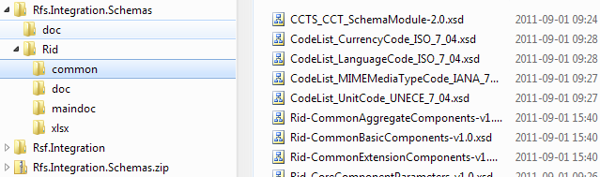
Filenames

Slide 14
Rfs Integration Dataschema (Rid)
Rid: first profile, used for ESB integration
Restriction of UBL 2.0 messages
Unknow messages based on UBL 2.1 messages
1st delivery (now)
Sales
ApplicationResponse
SalesOrder
SalesPackingList
SkuPackingList

Slide 15
Rid 2nd delivery sep 15th
Inventory
InventoryReport
StockAvailabilityReport
PurchasePackingList
StockRelocationRequest
Assortment
Item
ItemFulfilmentStatus
ItemPrice
Purchase
PurchaseOrder
PurchaseOrderResponse
SupplierParty
Optional
PurchaseOrderCancellation
SalesOrderCancellation

Slide 16
Rid message
Contain, for now, only restrictions on message level.
Common files untouched.
Extensions created for messages, common aggregated and basic components
Xlsx contains RFS hierarchy
Components have a default abbreviation
cbc, cac, qdt, udt, ecbc, ecac, …
An UBL hierarchy always ends with a cbc component
An extended hierarchy always ends with a cbc or an ecbc component

Slide 17
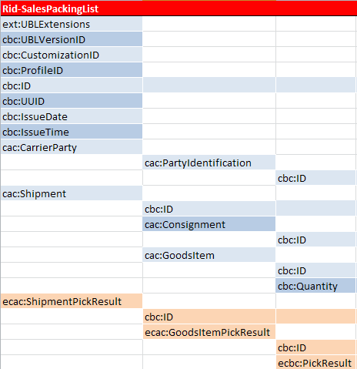
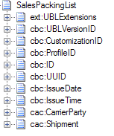
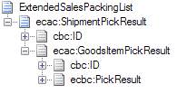
Rid message contents

Slide 18
Rid message contents
Restricting UBL means that within a message elements can be removed that are optional. Cardinality can be narrowed down in the following way:
0..n => 1..n
0..n => 1..1
0..n => m..n
1..n => 1..1
1..n => m..n
0..1 => 1

Slide 19
Rid message contents
ESB only validates UBL compliant messages
Extensions are stored in extension “bin”
Extensions have their own message:
Rid-Extended….xsd
Extension messages are referenced in:
Rid-ExtensionContentDatatype.xsd
Application transformation can validate extensions
Code- & datatype validation by app transformation

Slide 20
Rid To Do
Verify used fields and structure by Wehkamp & MS (AX team)
Change messages with verification input
Create “real” sample messages
Restrict datatypes
Define codevalues

Slide 21
Rid To Do
Create verification team
Work order:
Sales
Inventory
Assortment
Purchasing

